Slide 1

Benchmarking compositional data analysis methods for single-cell RNA-seq data
Yifan Duan
May 8th, 2024

Slide 2
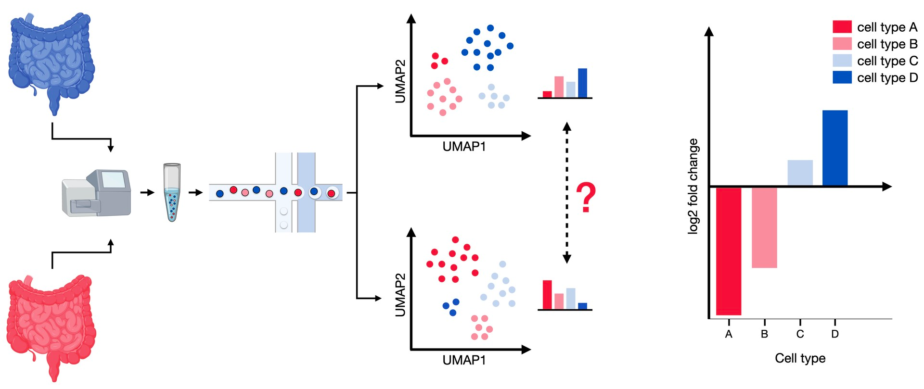
Motivation
We are interested in composition change of cell type in scRNA-seq
(Luecken and Theis, 2019)
Notes:
Provides gene expression data at the level of individual cells, allowing for the analysis of cellular heterogeneity within a population.
Allows the identification of rare cell types or subpopulations.
Provides insights into cell-to-cell variability and dynamics.
Can uncover rare or transient cell states.

Slide 3
Problem of compositionality
Compositionality: group proportions sum to one and are negatively correlated
Samples are dependent on each other
Univariate tests are not sufficient
Counts (relative counts): impossible to capture ALL cells
“constant sum constraint”
Low replicates (cost is high): decreased statistical power
Notes:
Metagenomics: bacteria composition in environment

Slide 4
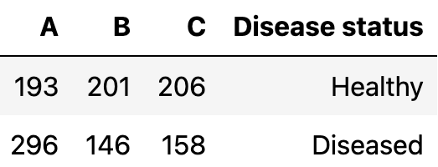
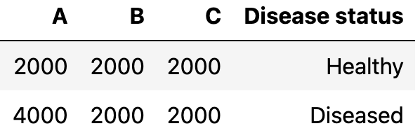
Change in composition
Ideal situation
Reality
Often not the case due to technical limitations
Did A increase?
Did B and/or C decrease?
All of the above?

Slide 5
Compositional data
All methods require at least these labels for each cell
Cell type label
Annotation of cell types, sometimes methods require a reference cell type
Condition label
Control vs diseased/developmental stage(s)
Sample label
Sample-to-sample variability needs to be accounted for (within a condition)
Needs at least 2 samples per condition (for most methods)

Slide 6
Checking with visualization?
“In the absence of dedicated tools, visual comparison of compositional data can be informative of changes in compositions between samples” (Luecken and Theis, 2019)

Slide 7
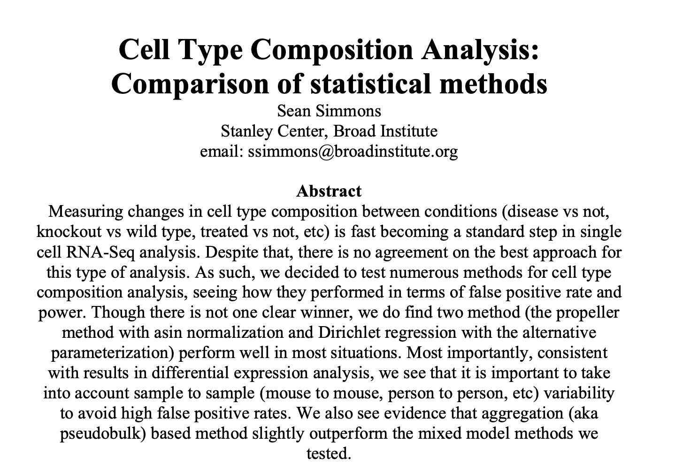
Current progress
Dr. Sean Simmons published on bioRXiv in 2022
Conclusion:
Propeller (logit-linear + limma)
Dirichlet regression
Newer methods that use Bayesian statistics have been developed

Slide 8
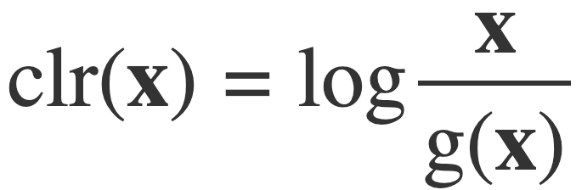
Methods
“Traditional” methods
T-test
Requires transformed data
Robust linear regression
Requires transformed data
Negative binomial
“In-house” method
Dirichlet-multinomial
Implemented with brms
Requires reference cell type
Published methods
Corncob (2020)
Beta-binomial
Propeller (2022)
Logit-linear + limma
sccomp (2023)
Sum-constrained beta-binomial
Notes:
dplyr::mutate(geom_mean = exp(mean(log(count), na.rm = TRUE)),
clr_Count = log(count / geom_mean))
CLR divides each compositional part by the geometric mean of all parts.

Slide 9
Aims
If there is no true change in proportion, how likely is a method to detect a significant change? (false positive)
If there is a true change in proportion, how likely is a method to detect it? (power)
If there is a true change in proportion but the sample size is low, how likely is a method to detect it? (downsampling)
Notes:
Statement instead of questions

Slide 10
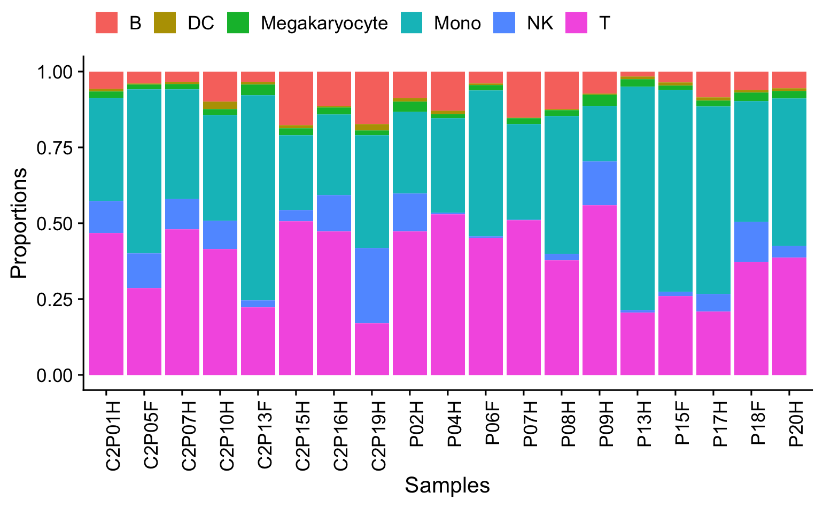
Immune Data
An immune-cell signature of bacterial sepsis (Reyes et al, Nature Medicine 2020)
6 immune cell types
Abundant (T, Mono)
Intermediate (NK, B)
Rare (Megakaryocyte, DC)
Filtered to control samples only (n=19)

Slide 11
False positive test workflow
Filter the immune data to control only (n=19)
01
Randomly select half (n=9), assign them to ‘treatment’
02
Perform statistical tests with various methods
03
Repeat this process for 100 times (bootstrapping)
04

Slide 12
Overview
Immune data (6 cell types)
19 control samples
Randomly assign half to “non-control” (n=9)
Bootstrap condition labels for robustness
False positive test
Ideally up to 5% should be significant

Slide 13
Evaluating FPR using control data
100 bootstrap iterations
6 cell types
All control samples
Any positives → false positives
Any negatives → true negatives
Notes:
Explain the CI graphs

Slide 14
Most methods performed well on the FP test
The most common threshold is 0.05 for FPR
FPR = FP / (FP + TN)
sccomp, rlm, and nb did not achieve the threshold

Slide 15
Effect estimates remained consistent
NK and B cells have more outliers in the effect estimate
Most methods have a median estimate of around 0
Rare cells and abundant cell affected similarly

Slide 16
Sample-to-sample variability affects FPR
Monocyte and NK cells are more prone to FP than other cell type
DM requires reference cell type (T)

Slide 17
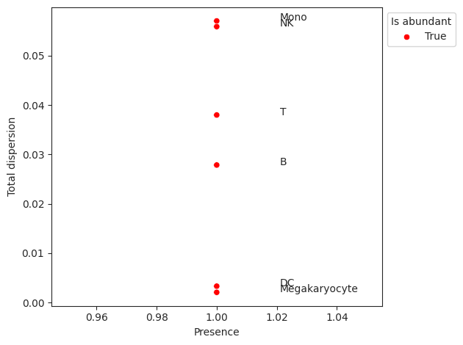
Mono & NK cells have higher dispersion

Slide 18
Overall ranking
FPR
Corncob
clr+t-test
Propeller
Dirichlet-multinomial
Sccomp
Clr+rlm
Negative binomial

Slide 19
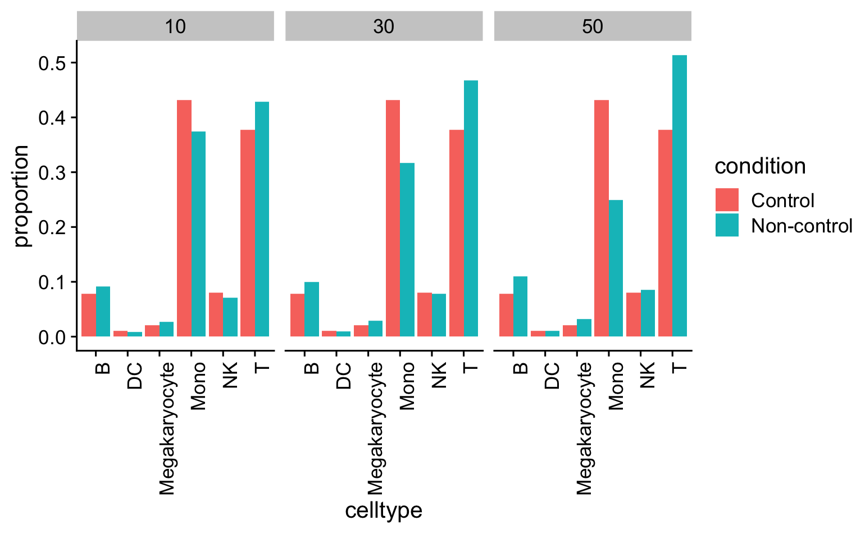
Overview
Immune data (6 cell types)
19 control samples
Randomly assign half to “non-control” (n=9)
Bootstrap condition labels for robustness
False positive test
Ideally up to 5% should be significant
Power test
Removing 10%, 30%, 50% of Monocyte
Adding 50%, 75%, 100% of DC
Converting 10%, 30%, 50% of NK to B
Notes:
Include data changed (perturbed data)
Overall ranking (weigh power more?)
Recheck label for graphs

Slide 20
Power test workflow
Filter the immune data to control only (n=19)
01
Randomly select half (n=9), assign them to ‘treatment’
02
Remove/Add some percentages of a specific cell type in the treatment
03
Perform statistical tests with various methods
04
Repeat this process for 50 times for each modification threshold (x%)
05

Slide 21
Traditional methods performed well with the deletion of abundant cell type
Power = 1 - FN / (TP + FN)
Notes:
Power = 1 – type 2 error = 1 - FN / (TP + FN)

Slide 22
sccomp has the most conservative estimate
10% deletion in Mono
30% deletion in Mono
50% deletion in Mono
Confidence interval aggregated with metafor

Slide 23
Most methods are specific to true changes

Slide 24
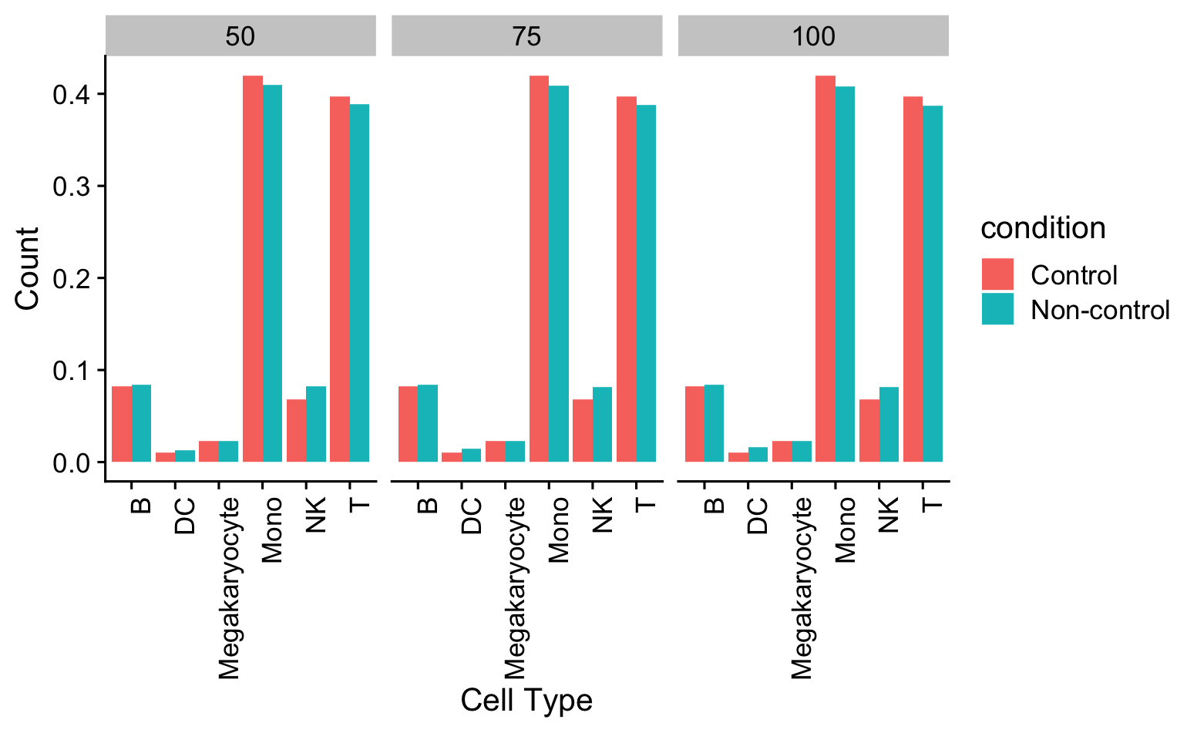
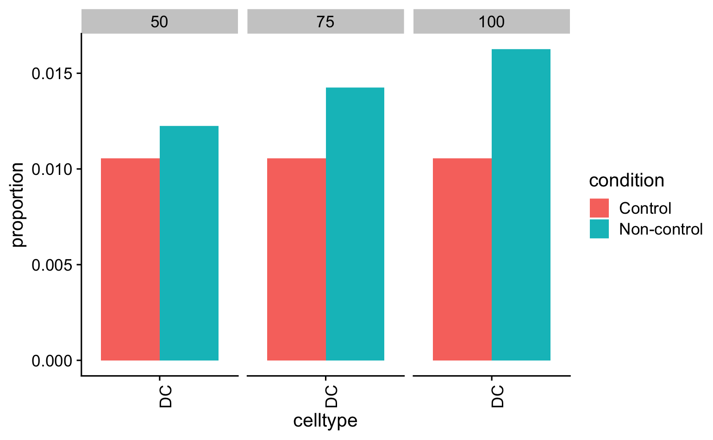
Overview
Immune data (6 cell types)
19 control samples
Randomly assign half to “non-control” (n=9)
Bootstrap condition labels for robustness
False positive test
Ideally up to 5% should be significant
Power test
Removing 10%, 30%, 50% of Monocyte
Adding 50%, 75%, 100% of DC
Converting 10%, 30%, 50% of NK to B

Slide 25
Dirichlet-multinomial performed poorly on addition of rare cell type

Slide 26
Bayesian methods performed poorly with effect estimates
50% increase in DC
75% increase in DC
100% increase in DC
Confidence interval aggregated with metafor

Slide 27
sccomp had the most “off-target” effect

Slide 28
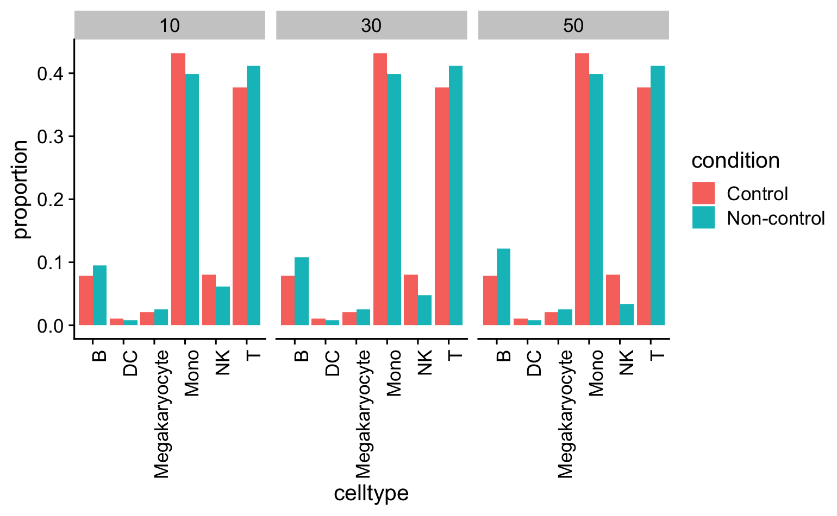
Overview
Immune data (6 cell types)
19 control samples
Randomly assign half to “non-control” (n=9)
Bootstrap condition labels for robustness
False positive test
Ideally up to 5% should be significant
Power test
Removing 10%, 30%, 50% of Monocyte
Adding 50%, 75%, 100% of DC
Converting 10%, 30%, 50% of NK to B

Slide 29
NK → B to simulate developmental change

Slide 30
All methods performed poorly on transient change

Slide 31
Overall ranking
FPR
Corncob
clr+t-test
Propeller
Dirichlet-multinomial
Sccomp
Clr+rlm
Negative binomial
Power
Negative binomial
Clr + rlm
Clr + t-test (tied)
Sccomp (tied)
Propeller
Dirichlet-multinomial
corncob

Slide 32
Overview
Immune data (6 cell types)
COVID19 data (18 cell types)
Zero imputed with multRepl
19 control samples
Randomly assign half to “non-control” (n=9)
Bootstrap condition labels for robustness
Agreement with literature
See if methods agree with the compositional change reported
False positive test
Ideally up to 5% should be significant
Power test
Removing 10%, 30%, 50% of Monocyte
Adding 50%, 75%, 100% of DC
Converting 10%, 30%, 50% of NK to B

Slide 33
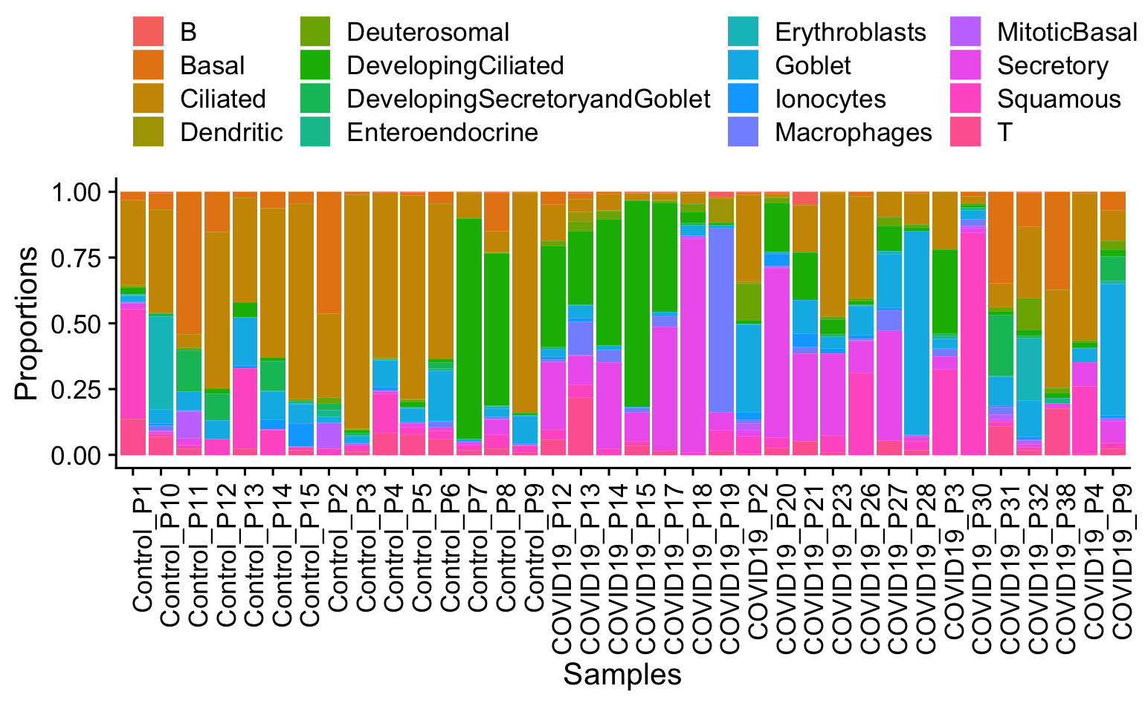
COVID Data
36 samples: 15 controls & 21 COVIDs
Impaired local intrinsic immunity to SARS-CoV-2 infection in severe COVID-19 (Ziegler et al, Cell 2021)
18 cell types
Reduced to 16 due to missing zeros
Multiplicative simple replacement preserves compositionality
Notes:
Why do we use it? A lot more cell type (more chaotic), also some changes are experimentally verified

Slide 34
All methods had high concordance with the paper
All 7 methods detected proportion changes for ciliated & secretory cells
Most methods detected proportion changes for Deuterosomal cells & Macrophages
An increase in secretory cells verified with flow cytometry (Ziegler et al. 2021)

Slide 35
Selection of reference cell type can mask true changes
Dirichlet-multinomial regression (brms, scCODA) requires choosing a reference cell type
Reference cell type should be unchanged and abundant
Dispersion in abundance
Iterate through all cell types

Slide 36
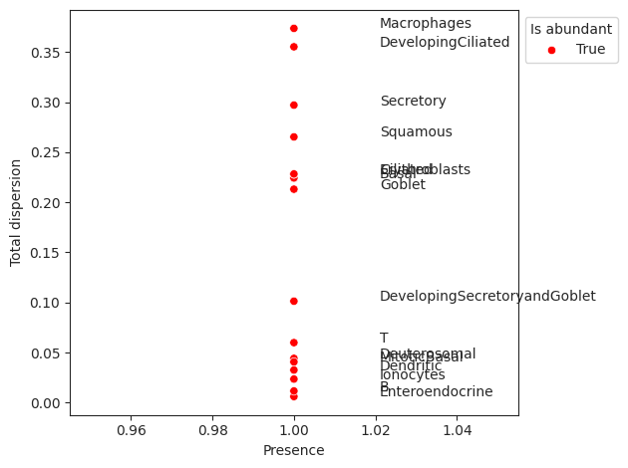
Highly dispersed cell types are likely to be changing composition

Slide 37
Overview
Immune data (6 cell types)
COVID19 data (18 cell types)
Zero imputed with multRepl
19 control samples
Randomly assign half to “non-control” (n=9)
Bootstrap condition labels for robustness
Agreement with literature
See if methods agree with the compositional change reported
False positive test
Ideally up to 5% should be significant
Downsampling test
Using 3, 5, 10 samples per condition to see if results are consistent
Power test
Removing 10%, 30%, 50% of Monocyte
Adding 50%, 75%, 100% of DC
Converting 10%, 30%, 50% of NK to B

Slide 38
Downsampling workflow
Randomly select 3, 5, 10 samples from each condition
01
Perform statistical tests with various methods
02
Filter the results to ciliated/secretory cells
03
Repeat this process for 10 times for each downsampling threshold
04

Slide 39
Traditional method performed well with low samples
Reduced the number of samples per condition
nb, corncob, rlm performed well with low sample size
Propeller performed the worst with n=3 & 5
Dm performed the worst with n=10

Slide 40
Overall ranking
FPR
Corncob
clr+t-test
Propeller
Dirichlet-multinomial
sccomp
Clr+rlm
Negative binomial
Power
Negative binomial
Clr + rlm
Clr + t-test (tied)
sccomp (tied)
Propeller
Dirichlet-multinomial
corncob
Downsampling
Corncob
Negative binomial
Clr + rlm
sccomp
Clr + t-test
Dirichlet-multinomial
propeller

Slide 41
Bayesian models have longer runtime
Bayesian-based methods have longer runtime
Frequentist-based methods run in an instant
Scalable since compositional data doesn’t require gene-level info

Slide 42
Conclusion
Traditional methods (e.g. t-test) perform well after transforming the data
Bayesian methods had intermediate performance in both false positive and power
Limitations: methods didn’t require cell type labeling (e.g. Milo) not benchmarked
Future direction: more bootstrap iteration

Slide 43
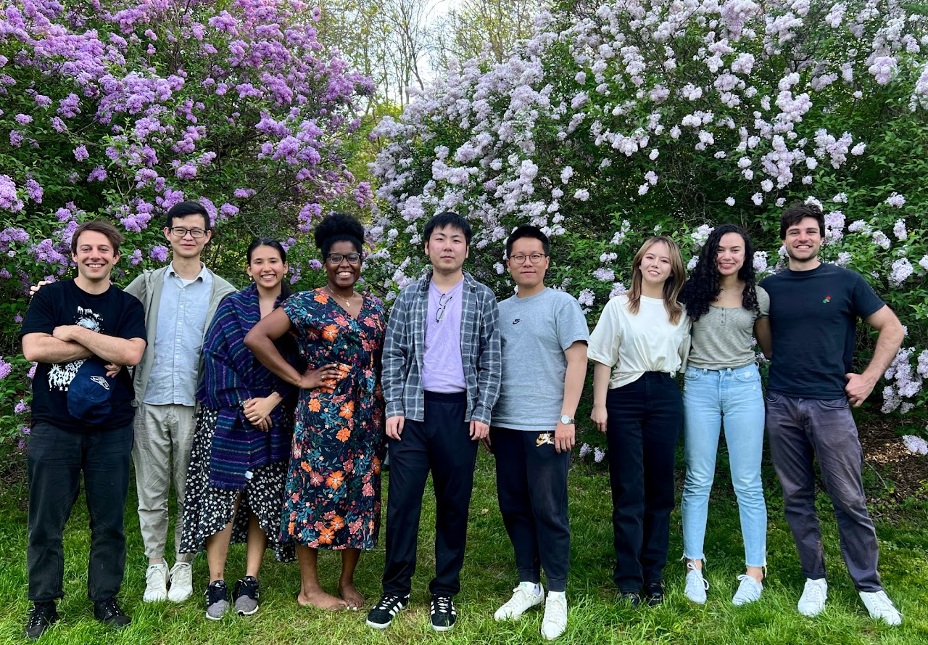
Acknowledgement
Haber Lab
Prof. Adam Haber
Midge van Aller
Dr. Sophia Carryl
Dr. Wenjiang Deng
Dr. Tiffany Zhang
Nicole Almanzar
Evan Lemire
Zichuan (Bryce) Li
Maia Mesyngier
CBQG Program
Prof. John Quackenbush
David Cruikshank
Jelena Follweiler

